Slide 1

Word Search Generator
An Interactive Puzzle Generation System
Introduction to Programming Language I Project

Slide 2
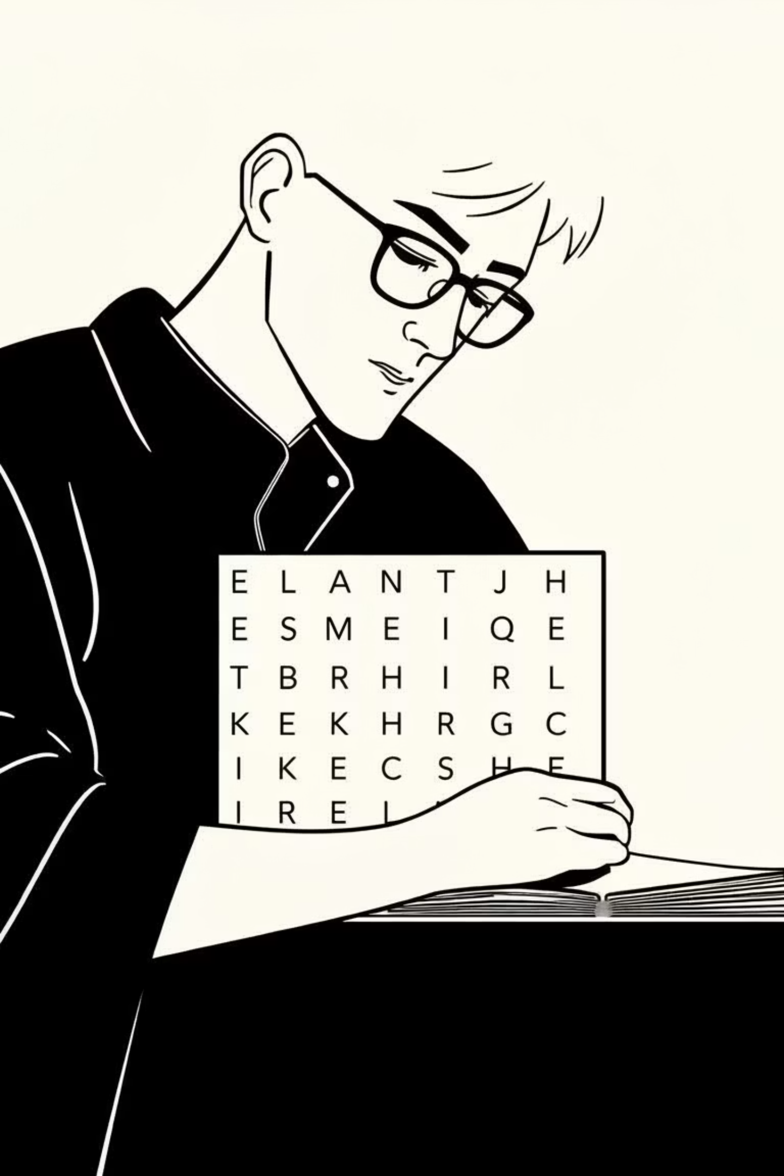
The Problem: Manual Puzzle Creation
Time-Consuming
Prone to Errors
Manually crafting word search puzzles is a laborious and repetitive task, especially for large word lists.
Human errors in placement can lead to overlapping words or incorrectly hidden solutions, reducing puzzle quality.
Lack of Variety
Traditional methods often result in predictable layouts, limiting the complexity and engagement of the puzzles.

Slide 3


Project Objectives
Automated Generation
Develop a console-based C application to automatically generate dynamic square word search grids.
Diverse Word Placement
Implement algorithms for hiding words horizontally, vertically, and diagonally, ensuring variety.
Interactive Validation
Enable real-time user input validation against a dictionary and provide visual feedback for correct guesses.
External Word Loading
Allow puzzles to be customized by loading word lists from external text files for flexible content.

Slide 4
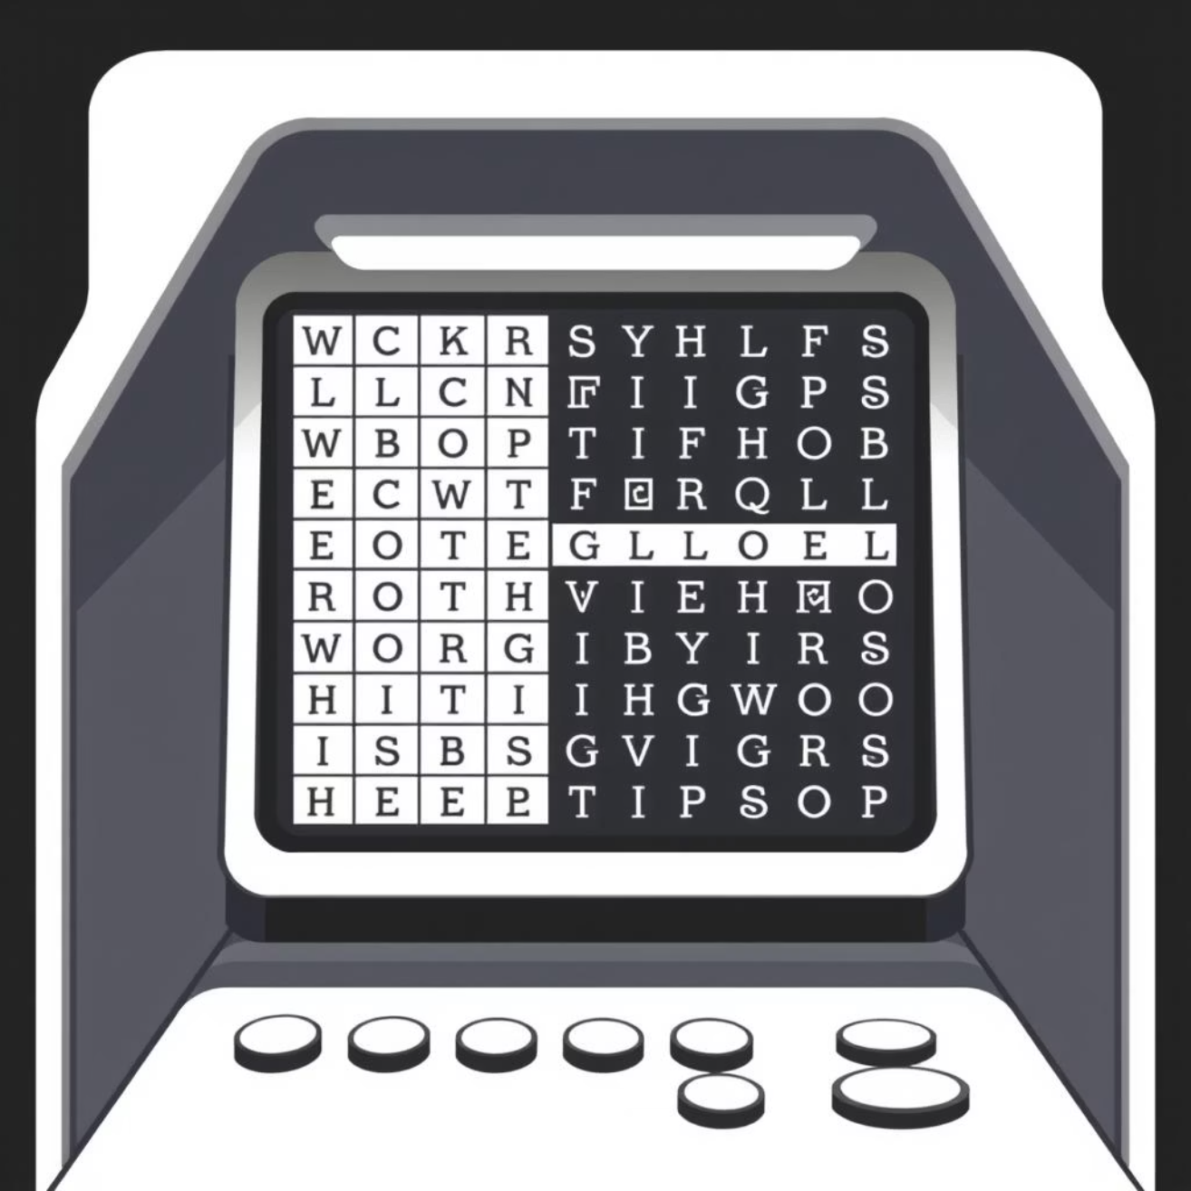


System Overview & Key Features
Dynamic Grid Creation
Adjustable square grid size based on word list length for optimal density.
Randomized Placement
Words are hidden in all eight directions (horizontal, vertical, diagonal) to maximize challenge.
Dictionary Validation
User guesses are checked against a comprehensive list of valid words to ensure accuracy.
Visual Feedback
Correctly found words are highlighted on the console, enhancing the user experience.
Customizable Word Lists
Users can supply their own word files, making the generator versatile for various themes.

Slide 5


Algorithms & Methodology
Our approach combines efficient data structures and strategic algorithms to ensure robust puzzle generation.
Load Words
Generate Grid
Search & Validate
Grid Initialization
A dynamic 2D array is created and filled with random letters from the alphabet.
Word Placement Strategy
Words are attempted to be placed at random positions and directions, prioritizing longer words first to reduce conflicts.
Conflict Resolution
Algorithms ensure words do not overlap incorrectly, or if they do, they share common letters appropriately.
Search & Highlight
User input triggers a search function, which, upon finding a match, updates the grid's display with highlighting.

Slide 6
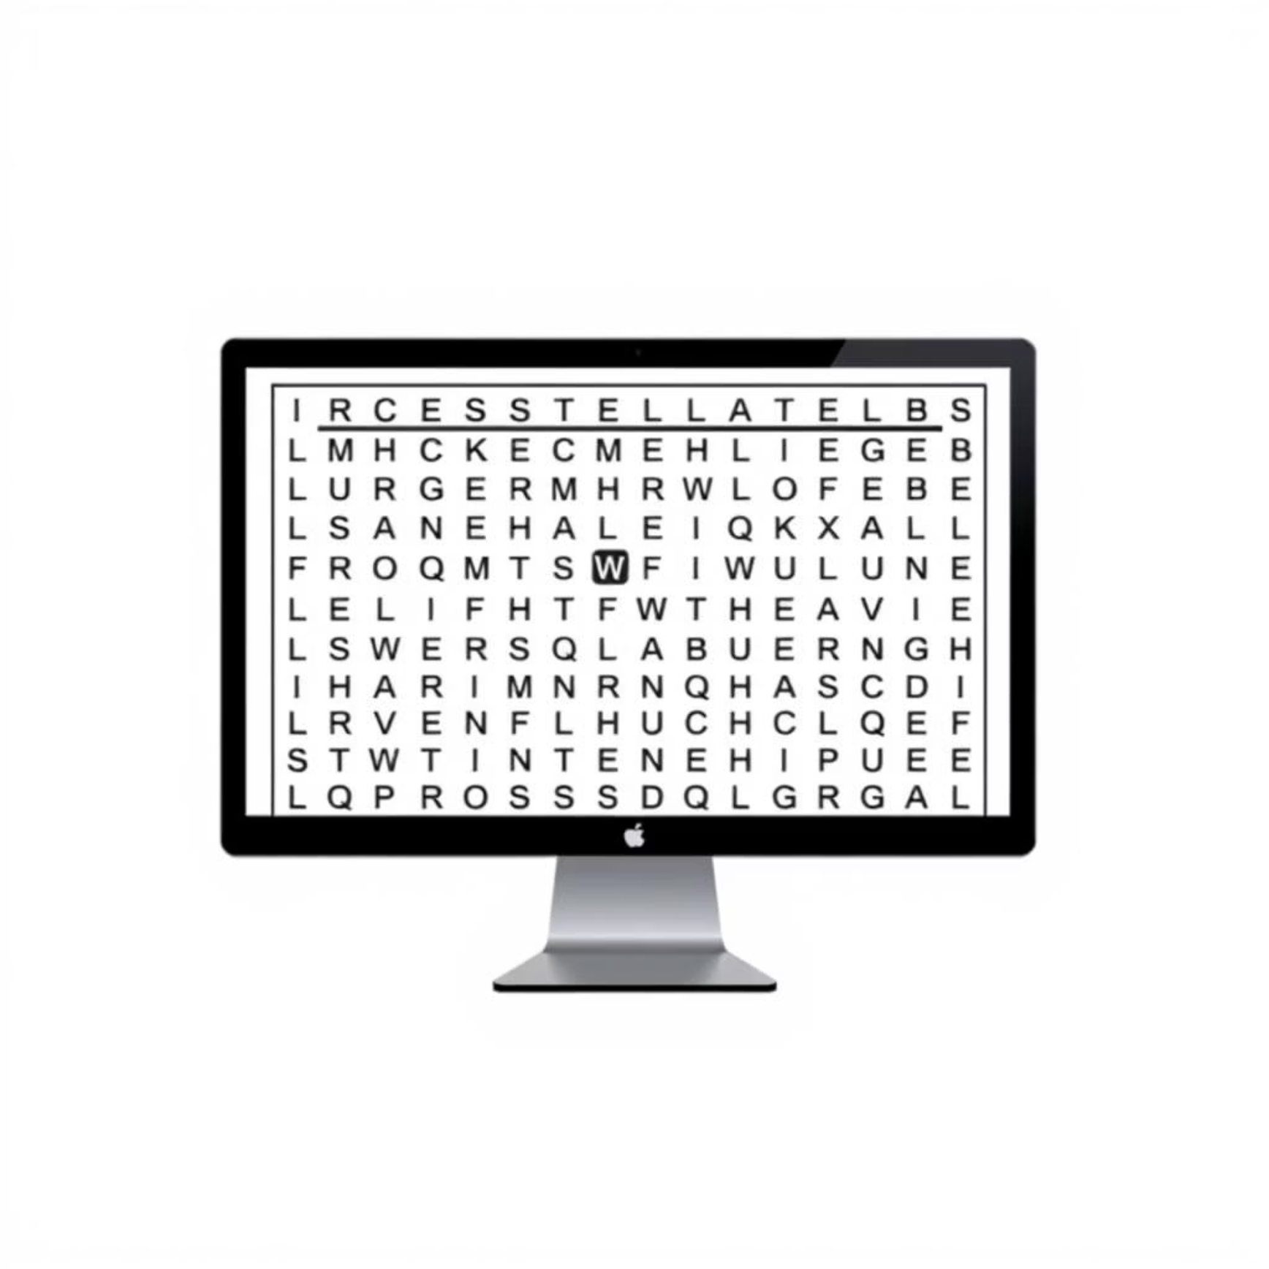


Results & Applications
Key Outcomes
Successfully developed a fully functional, console-based word search generator in C.
Achieved dynamic puzzle generation with varied word orientations.
Integrated robust word validation and interactive feedback for users.
Demonstrated efficient use of memory and processing for puzzle creation.
Potential Applications
Educational Tool
Cognitive Stimulation
Customized Entertainment
Create engaging vocabulary exercises for students of all ages.
Provide brain-teasing puzzles for leisure and mental exercise.
Generate themed puzzles for events, parties, or personalized gifts.

Slide 7


Conclusion & Future Scope
The Word Search Generator successfully meets its core objectives, providing a robust and interactive puzzle experience.
Enhanced UI
More Puzzle Types
Develop a graphical user interface (GUI) for a more intuitive and visually appealing experience.
Incorporate additional puzzle variations, such as crosswords or cryptograms.
Multiplayer Mode
Advanced Customization
Implement online functionality for competitive or collaborative puzzle-solving.
Allow users to define custom grid shapes, background themes, and letter distributions.

Slide 8
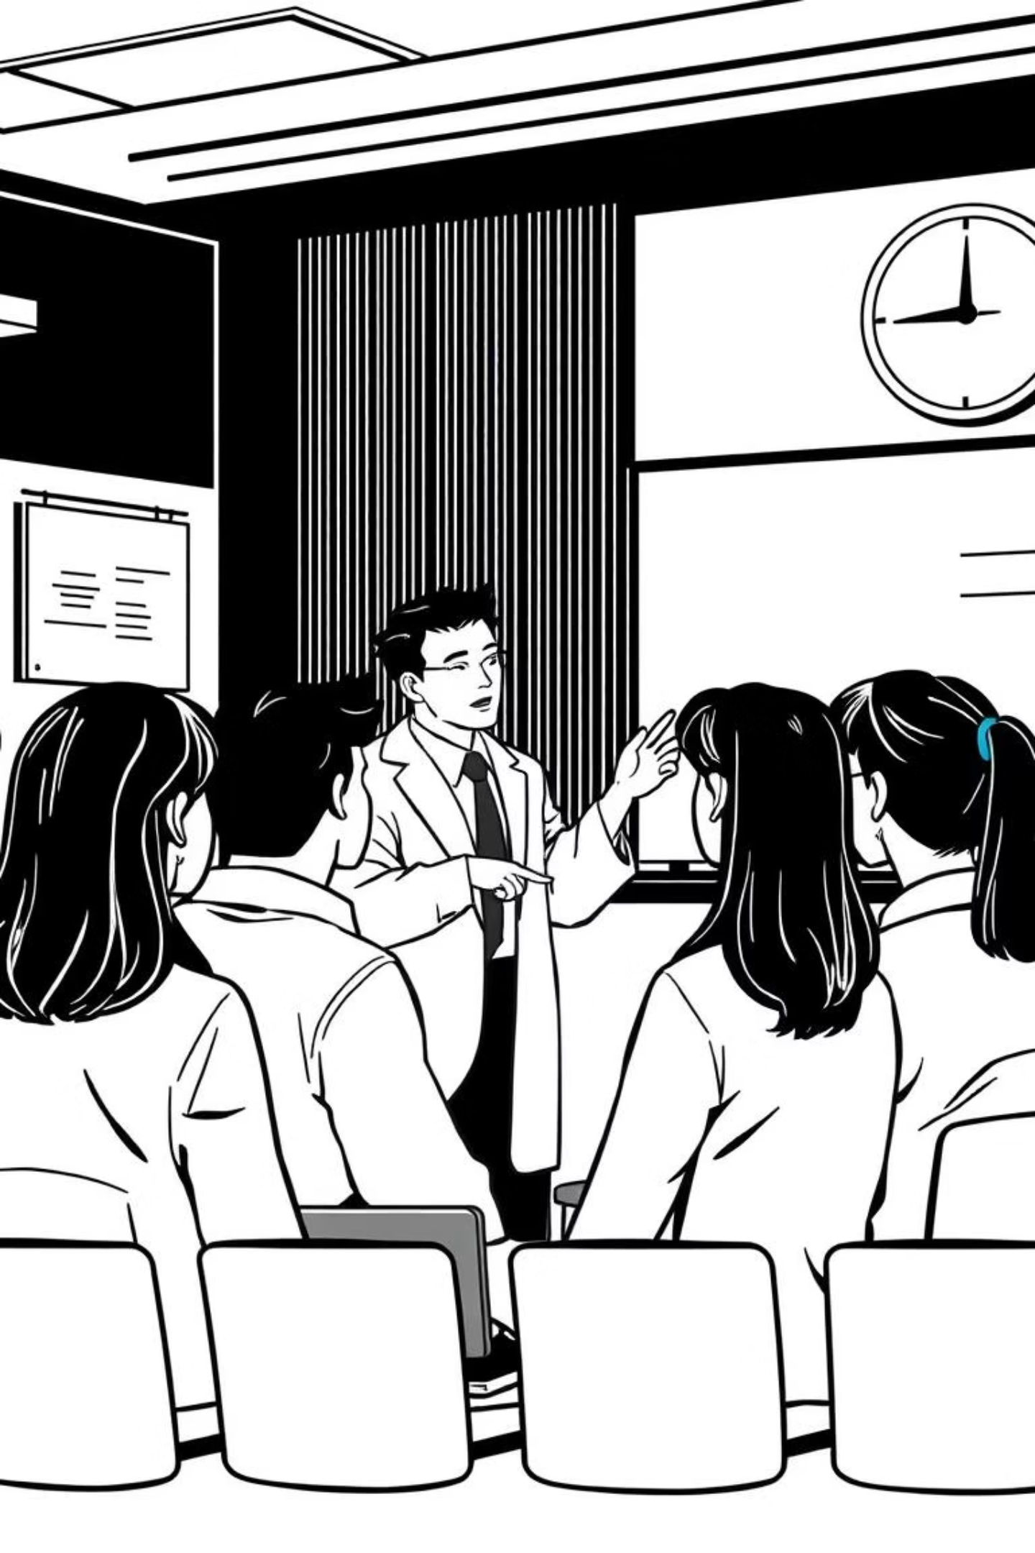



Thank You
This project was a semester-long endeavor in C programming, exploring algorithm design and interactive console application development.
Developed by Gourab Datta Kabbo, Sudip Saha and Ajoy Ghosh Ucchas.

